Slide 1

Development of MCQ System
Module : Programming Foundations
Learner Name : Ida Bagus Ketut Yoghantara
Class : BDSE04-0322

Slide 2
Project Presentation Objective
Task 5 -List and briefly explain the steps you will follow from writing code to execution. -Provide screen capture where possible.
Task 7 -Explain briefly how you manage the development process. -Provide screen capture of the various use of IDE during the development process.
Task 10 -List Coding standards you have using in the development of the application and explain 5 of them briefly with its importance.

Slide 3
TASK 5 SOLUTION
Defining the problem Before writing the code it’s better to know what are the problem first. In this project of developing a MCQ System, there are some problem that can be defined like: - What should we use to take user input from console - How to read and display the CSV file from java program - How to validate user input - How to make the score when the user answering the MCQ
Planning the solution After we defining the problem, the next step is planning the solution. These are the solution for given problem above: - Using Scanner to take user input from console - Reading the CSV file using FileReader - Using if-else statement and loop to validate the user input - Using variable score and add the score when the user answer correctly

Slide 4

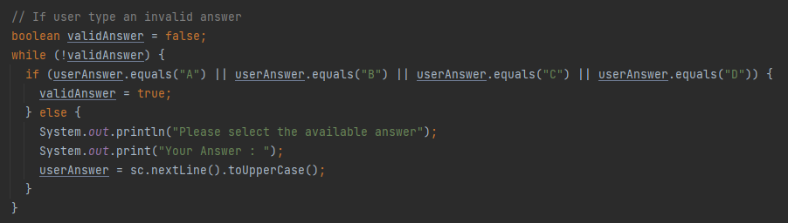
Coding the program After defining and planning the problem is done, we can now start to code the program according to the plan. - Taking user input using Scanner - Reading the CSV file using FileReader - Validate user input so they type correct input

Slide 5

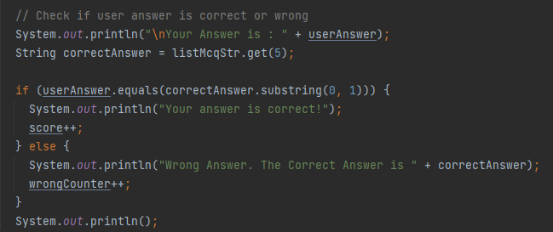
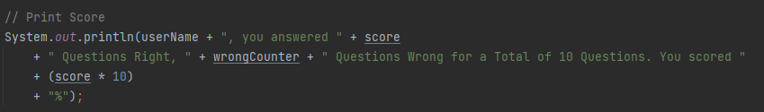
- Checking user answer are correct or wrong and calculating user Score

Slide 6
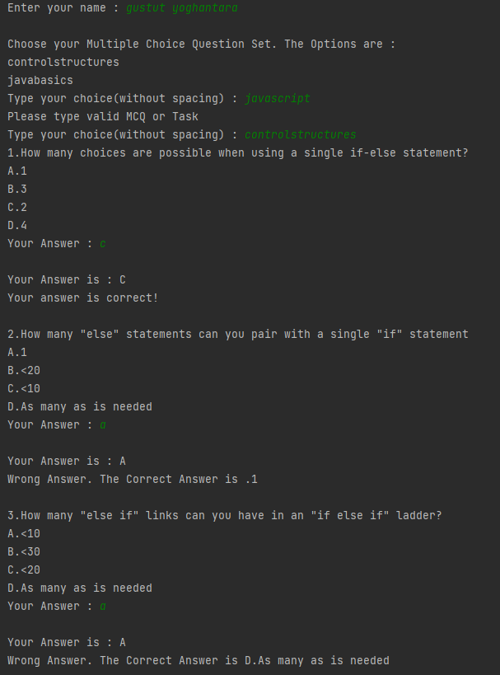
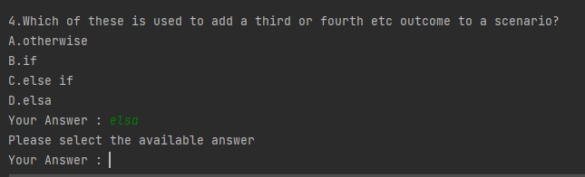
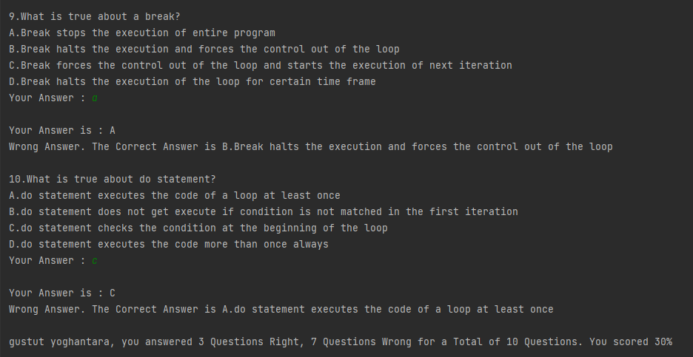
- Testing the program

Slide 7
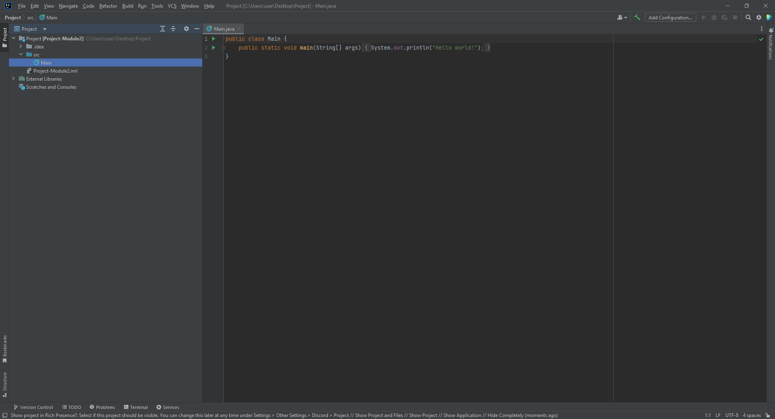
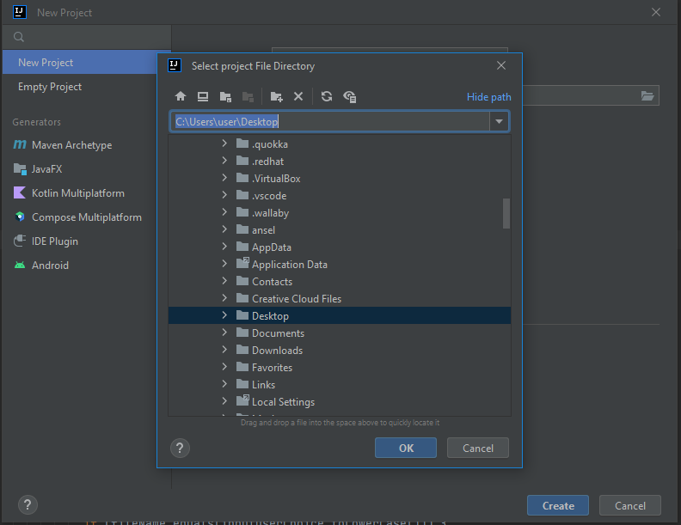
TASK 7 SOLUTION
Creating a new project First step is creating a new project. Choose where do you want to save your new project and clicking the “Create” button to create the new project.

Slide 8
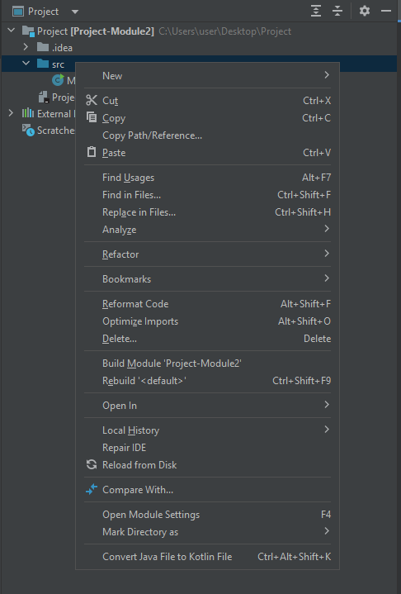
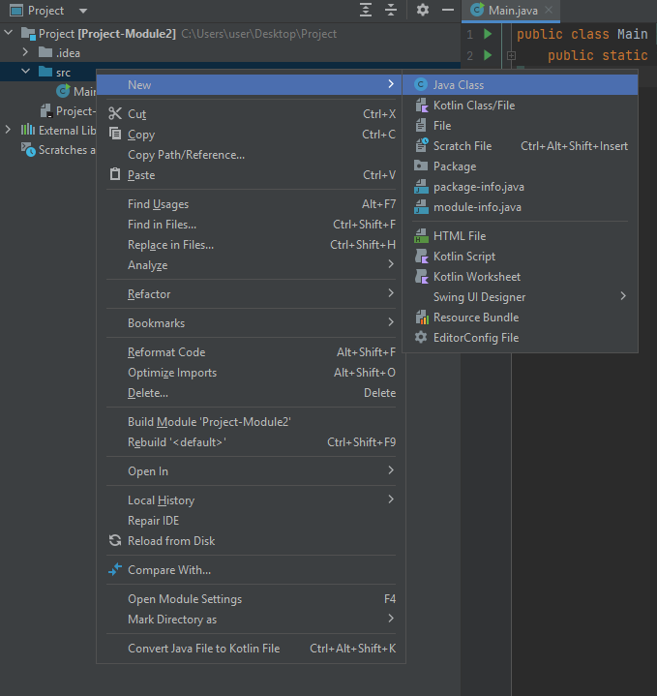
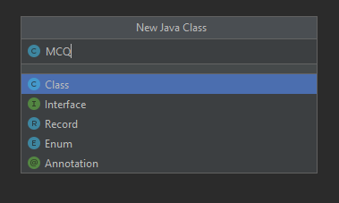
Creating Java Class Creating new Java Class by right clicking the “src” folder and then choose new -> java class. After that write the class name without the extension.

Slide 9
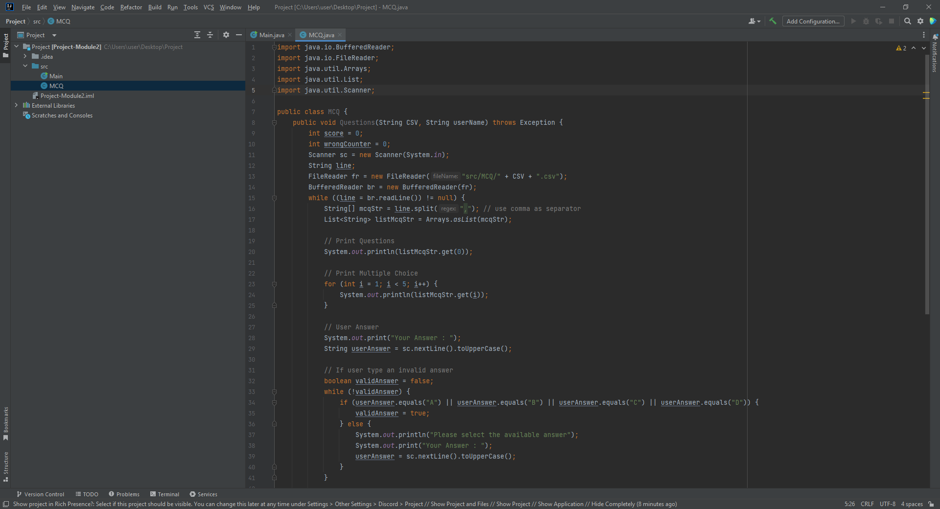
Code the program Write the program according to the given problem.

Slide 10
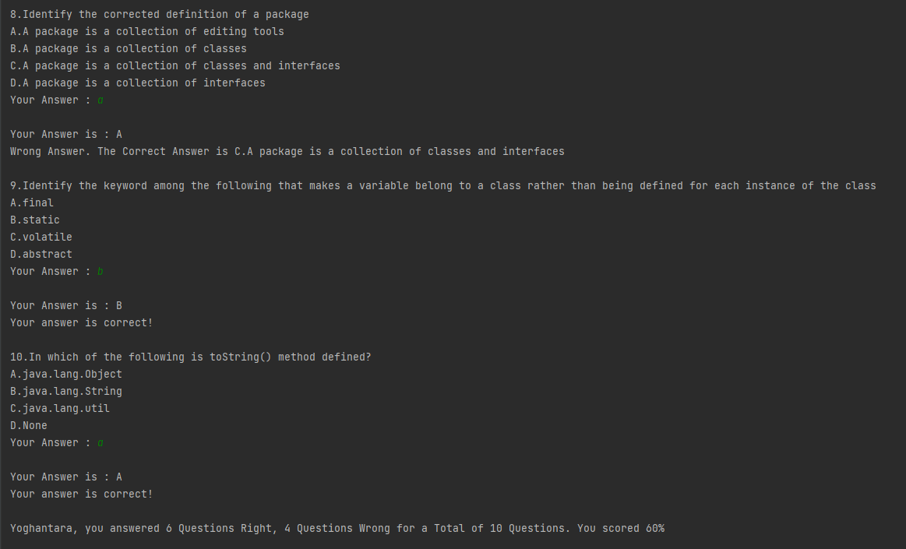
Testing The Program After writing the program, we should tested the functionality of the program.

Slide 11
TASK 10 SOLUTION
Coding Standards 1. Naming Conventions Java naming conventions are set of rules to make Java code look uniform across Java projects and the library. They are not strict rules, but a guideline to adhere to as a good programming practice. - Class is typed in uppercase: Main, MCQ - Methods and variables names are typed in a camel case: generateFilesName, questions, score. These conventions have become so much apart of Java that almost every programmer follows them religiously. As a result, any change in this looks outlandish and wrong. An obvious benefit of following these conventions is that the style of code aligns with the library or framework code. It also helps other programmers to quickly pick up the code when they have to, therefore leveraging overall readability of the code.

Slide 12
Variable Scope In Java, every variable declared has a scope. This means that the visibility and use of the variables must be restricted within the scope only. In case of a local variable, it is visible from the point of its declaration to the end of the method or code block it is declared in. It is a good practice to declare a variable close to the point of its possible use. This not only enhances readability of the code but also makes debugging simpler.
Class Fields In Java, methods either belong to a class or to an interface. Therefore, there is a chance that local variables may be given the same name as a class member variable unintentionally by the programmer. The Java compiler, however, is able to pick the right one from the scope. Also, modern IDEs are sophisticated enough to identify the conflict. In any case, programmers themselves should be responsible enough to avoid such conflicts because the result can be quite disastrous. The following code illustrates how we get a very different result if we do not take care of conflicting variable names.

Slide 13
Standard Libraries Java is known for its rich set of libraries. However, it is not that every library is perfectly designed but for the most part of it they are optimal. Java releases new libraries every now and then and improves the existing ones actively. Therefore, one should always use classes, methods, interfaces, enums, and annotations from the library as much as possible. This can reduce production time considerably. Moreover, the features included are well tested. It is better to use a them from the library whenever required rather than reinvent the wheel. Because the Java platform evolves frequently, it is extremely important that we keep an eye on the features which we include from the third-party libraries or frameworks are already present in the Java Standard Library. The rule of thumb is to first exhaust the in-house resource before culling support from external sources.
Comments: In-line In-line comments should be used to explain complicated sections of code, such as loops. Use the // comment delimiter for in-line comments. Do not comment generally known features of the java language.

Slide 14
Classes and Methods
Class - Main Class - MCQ Class
Methods - generateFilesName - questions

Slide 15
Development Tools
Intellij IDEA IntelliJ IDEA is an intelligent, context-aware IDE for working with Java and other JVM languages like Kotlin, Scala, and Groovy on all sorts of applications.
Visual Studio Code Visual Studio Code features a lightning fast source code editor, perfect for day-to-day use. With support for hundreds of languages, VS Code helps you be instantly productive with syntax highlighting, bracket-matching, auto-indentation, box-selection, snippets, and more.

Slide 16



Project Deliverables
Project Deliverables a. MCQ System b. MCQ Set (CSV Files) c. Project Report d. Project Presentation e. Source Code
List of Evidences

Slide 17
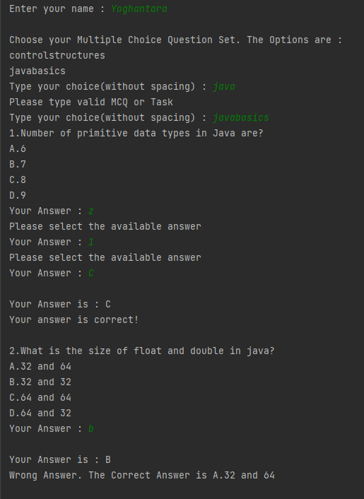
Project Results

Slide 18
List of References
Linkedin.com/learning
W3school.com
Youtube.com
Geeksforgeeks.org
Javatpoint.com
Stack overflow
Jetbrains.com
Quizizz.com
Developer.com

Slide 19
Milestone Feedback & Action taken
Project Milestone ID | Milestone Feedback received from Tutor / Learning Facilitator | Action Taken (Yes / No)
1 | Revise project result screenshot, list evidences & add project deliverables | Yes
2 | Adding milestone feedback in project presentation | Yes

